Slide 1
Database Normalization

Slide 2
Definition
Database normalization is the process of structuring a database to reduce redundancy and dependency by organizing data into related tables according to a series of normal forms.
It involves dividing large tables into smaller, related tables and defining relationships between them.
The primary goal is to eliminate redundant data (duplicate information) and ensure that data dependencies make sense, which helps maintain consistency and efficiency in the database.
Normalization follows a series of rules called normal forms , each addressing specific issues related to data redundancy and dependency.

Slide 3
Key Objectives of Normalization
Eliminate Redundant Data : Avoid storing the same data in multiple places to save space and reduce inconsistencies.
Ensure Data Integrity : Prevent anomalies (insertion, update, deletion) that can arise from poorly structured tables.
Improve Query Efficiency : Well-structured tables allow for faster and more efficient queries.
Simplify Maintenance : A normalized database is easier to update and maintain over time.

Slide 4
Normal Forms
Normalization is achieved by applying a series of rules called normal forms .
Each normal form builds on the previous one, progressively refining the database structure.
In DBMS, "normal form" refers to a set of rules or stages in database normalization, a process that organizes data to minimize redundancy and improve data integrity by structuring tables and defining relationships between them.

Slide 5

Unnormalized Table :
Consider a database for managing employees, their projects, the tools they use, and their hobbies. The initial unnormalized table looks like this:
Repeating Groups : Projects, ToolsUsed, and Hobbies are stored as comma-separated lists.

Slide 6
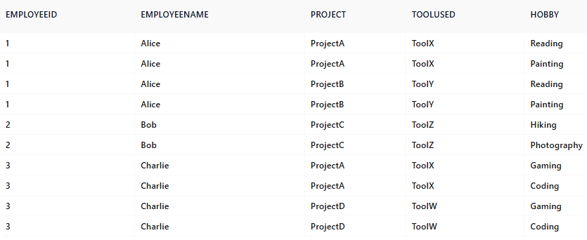
First Normal Form (1NF) :
A table is in 1NF if it contains only atomic (indivisible) values and each column contains values of a single type.
To achieve 1NF , eliminate repeating groups by splitting the comma-separated values into individual rows.
Redundancy : EmployeeName is repeated for every combination of project, tool, and hobby.
Partial Dependencies : EmployeeName depends only on EmployeeID, not the full key {EmployeeID, Project, ToolUsed, Hobby}.

Slide 7

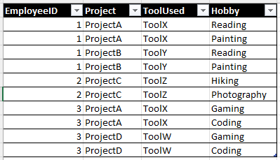
Second Normal Form (2NF) :
A table is in 2NF if it is in 1NF and all non-key attributes are fully functionally dependent on the primary key.
Key Rule : Remove partial dependencies (non-key attributes should not depend on part of a composite primary key).
Table 1: EmployeeName Table 2: employeeProjects_Tools_Hobbies
Transitive Dependency : ToolUsed and Hobby are independent of each other but both depend on EmployeeID.

Slide 8


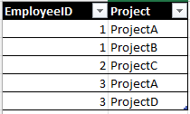
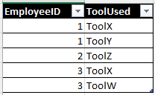
Third Normal Form (3NF) :
A table is in 3NF if it is in 2NF and all non-key attributes are transitively dependent on the primary key.
Key Rule : Remove transitive dependencies (i.e., non-key attributes should not depend on other non-key attributes).

Slide 9
Fourth Normal Form (4NF) :
A table is in 4NF if it is in BCNF (Boyce–Codd normal form) and has no multi-valued dependencies (except those implied by the primary key).
Boyce-Codd Normal Form (BCNF) states that every column in a table must relate directly to the entire primary key and nothing but the primary key.
Key Rule : Remove multi-valued dependencies.
Fifth Normal Form (5NF) :
It cannot be decomposed into any number of smaller tables without loss of data.
Deals with cases where a table involves multiple independent relationships.
Key Rule : Ensure that any join dependencies are preserved.
Rarely used in practice but ensures complete decomposition of complex relationships.

Slide 10
Benefits of Normalization
Reduces Data Redundancy : Minimizes duplicate data, saving storage space.
Improves Data Integrity : Ensures consistency by eliminating anomalies during insertions, updates, and deletions.
Facilitates Scalability : Makes it easier to extend the database schema as requirements evolve.
Enhances Query Performance : Well-structured tables often lead to faster and more efficient queries.

Slide 11
Drawbacks of Normalization
Increased Complexity : Highly normalized databases can become difficult to design and query.
Performance Overhead : Excessive joins between tables may slow down query performance.
Not Always Practical : In some cases ,denormalization is preferred for faster read operations.

Slide 12
Conclusion
Normalization is a fundamental concept in relational database design that helps create efficient, consistent, and maintainable databases.
Through utilizing normal forms, you can systematically organize your data to minimize redundancy and dependency issues.
However, the level of normalization depends on the specific use case, and sometimes denormalization is necessary to balance performance and usability.

